Slide 1
TOPIC: FALLAIN APP - A HEALTH COMPANION APPLICATION
Gabriel Edrian A. Alvaro and Ramil D. Manalo

Slide 2
Description: A website application that can help the user become more aware of his\her illness this includes how to cure the illness as well with the use of things available in every households. (natural remedy)

Slide 3
Fallain Console Application
“Fallain” is a Scots Gaelic word meaning Healthy. Which the name of the “Fallain” website comes from.

Slide 4
Main goal of the program:
To increase the user’s knowledge about his or her illness.
To make the user more aware of the illness that his or her is experiencing.
To guide the user on what he or she should do to treat his or her illness in the natural way.

Slide 5
Beneficiaries: It can be: 1. Students
2. Parents
3. Employee Or anyone who had an internet connection and a gadget to access the internet.

Slide 6
Flow of the program:

Slide 7
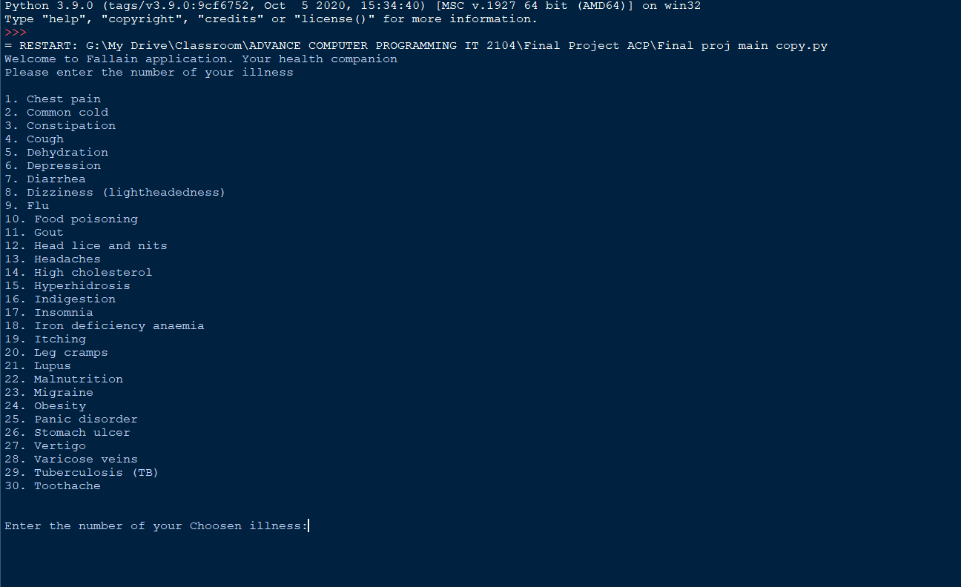
1. Flash to screen “Welcome to Fallain application, your health companion” with the 30 most common illness.

Slide 8
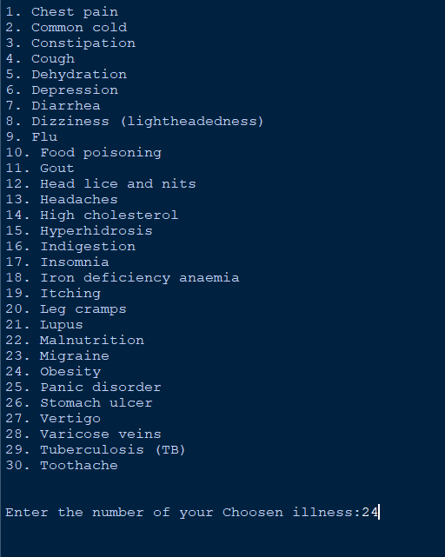
2. The user need to input his or her number according to his\her illness

Slide 9
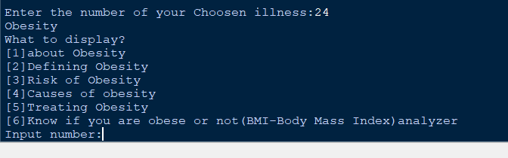
3. The program will display the selected number of illness
The illness displayed contains:
knowledge about the users illness
symptoms
cause of his\her illness
how to treat the users illness
And other available information in the program indicated on it.

Slide 10
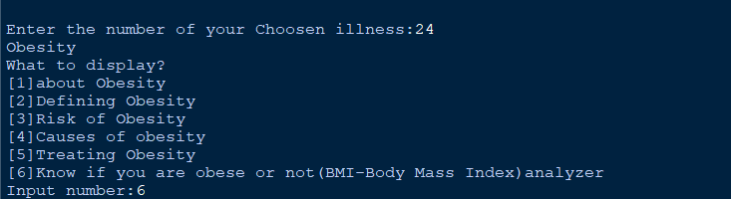
Here, the user choose number 6, an option that will determine if the user was overweight (Has a possibility to become obese) and underweight.
The user can also type other number that will give him or her the information he/she wants. E.g. About obesity, Defining Obesity, Risk of obesity, Causes of Obesity, and other available information in the system.

Slide 11
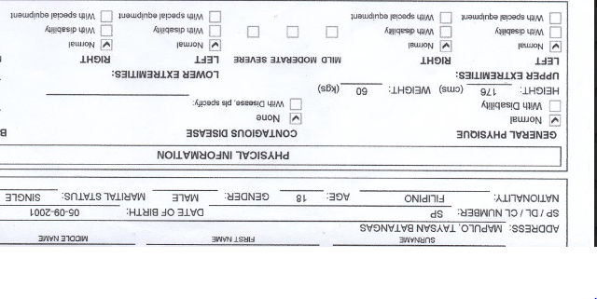
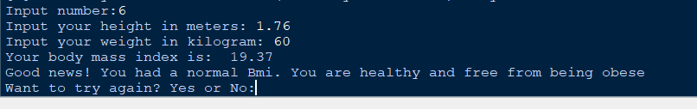
Here, my height is 176 in cm. It’s equivalent to meters is 1.76 meters. And meters is the required unit of the system
From the information on the photo, the user named Gabriel Edrian Alvaro input His height of 1.76 meters and weight of 60 kilograms. Which then process by the system and resulted to a good news.

Slide 12
After the user is finished from the selected option, the system will then flash the message ‘Want to try again? Yes or No:’ If yes, the program will let the user to select again to the list of illness. And if No, the program will end.

Slide 13
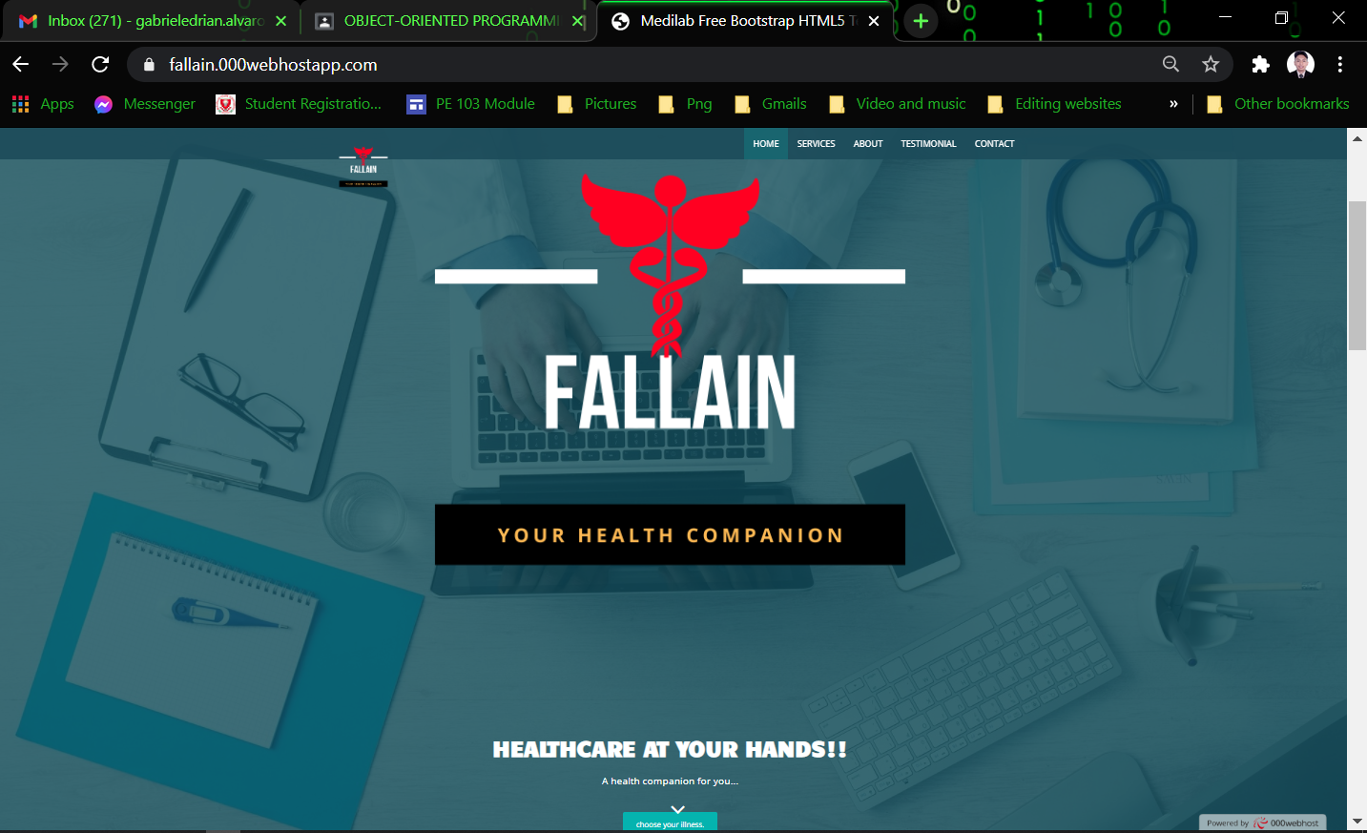
For visual presentation only:
https://fallain.000webhostapp.com/

